Slide 1
FORCE AND LAWS OF MOTION

Slide 2
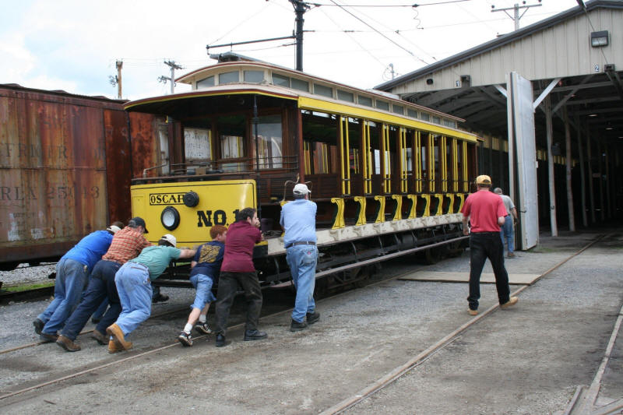
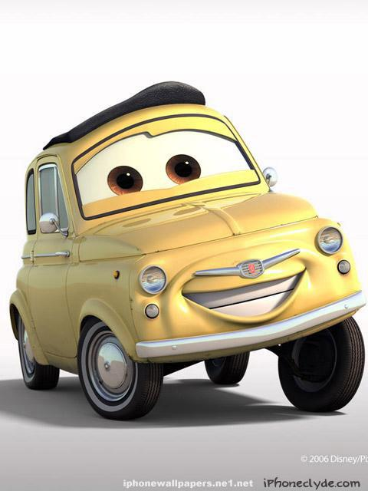
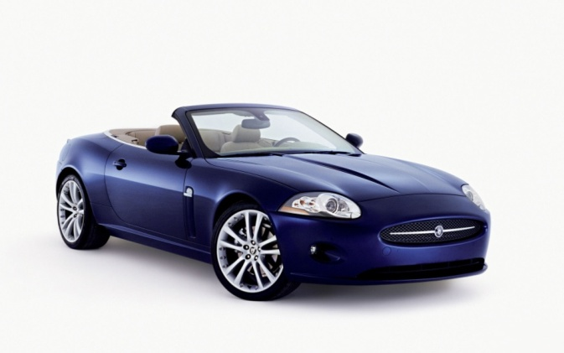
FORCE AND LAWS OF MOTION
LAWS
MOTION
Means
Object is in motion when
It changes its
Position with
time
What causes motion ??
Let us consider few examples
Rules
Causes of motion is force
We can say that the car is being pulled by the tow van
In the picture we can see people pushing the wagon
pulled
pushing
FORCE
Simple push or pull is FORCE!!
Pull is FORCE
FORCE

Slide 3

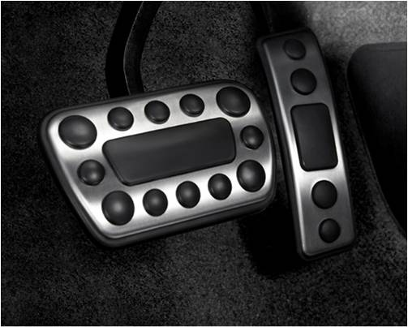
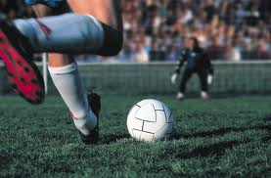
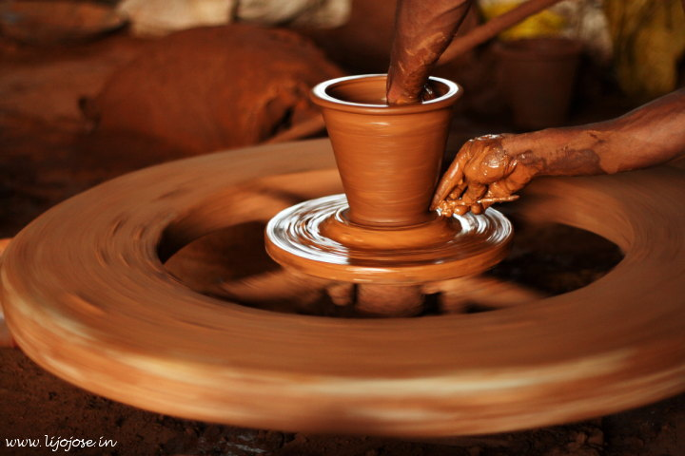
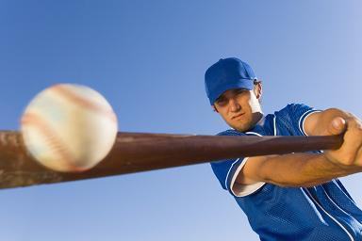


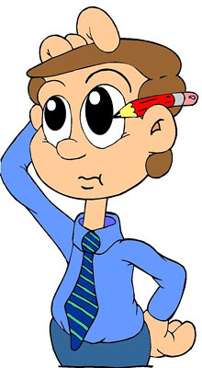
2. MOTION → REST
EFFECTS OF FORCE
EFFECTS OF FORCE
3. CHANGE IN SPEED
4. CHANGE IN DIRECTION
5. CHANGE IN SHAPE
REST → MOTION
By its effects
So, the different effects of force are….
FORCE (caught) is used to change from motion to rest
FORCE (mould) is used to change shape
Can force be seen or tasted???
FORCE (Kick) is used to change from rest to motion
Result
FORCE (brakes / accelerator) is used to change the speed.
NO!!!
FORCE (hit) is used to change the direction.
How do you know there is force ?
effects
The potter is moulding the clay.
The ball is caught by the fielder
When the ball is kicked ball moves.
By stepping brakes / accelerator speed changes
The player hits the ball to change the direction.

Slide 4




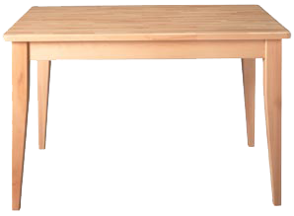
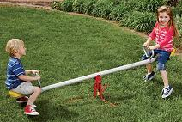
FORCES
Are there different kinds of Forces?
FORCES
Are of two types
Yes….!!!!!!
The table is exerting an upward force on the book and the weight of the book is in the downward direction
BALANCED FORCES
UNBALANCED FORCES
Forces which are equal in
magnitude and opposite in
direction acting on the same
body
2. They do not change the state
Forces which are unequal in magnitude and acting on the same body
The children are exerting unequal forces on the seesaw
Changes the state of rest or of motion. Causes acceleration in a body
of rest or of uniform motion
Change in velocity
Rate of change of velocity
time

Slide 5

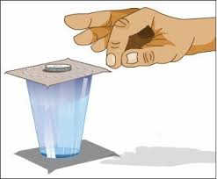
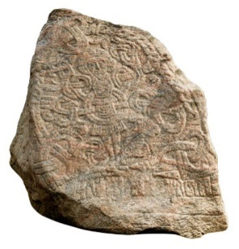
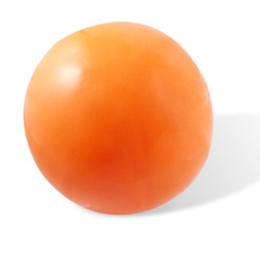
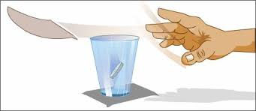

INERTIA
When the playing card is flicked the coin placed over it falls in the tumbler
This is because the coin does not move with the card because of
Inertia is the natural tendency of an object to resist a change in its state of motion or of rest.
Which needs greater force to bring about a change in its state??
Why??
Let us consider a card placed on a glass and a coin placed on the card.
Means to resist
resist
Ball and stone are of same size but have different masses. So stone will need greater force to bring about a change due to it greater inertia
Let us consider an example.
Mass of an object is a measure of its inertia
Luggage is tied to the roof to prevent them from falling due to inertia
Greater the mass greater is its inertia.
Inertia
Why..??
When the card is flicked with the finger the coin placed over it falls in the tumbler
Plastic ball and stone of same size

Slide 6
Newton’s Laws of Motion
Newton’s Laws of Motion
Means rules
Newton studied ideas on force and motion and presented three Fundamental Laws.
These Laws are known as…..

Slide 7


NEWTON’S FIRST LAW OF MOTION
Forced to
Newton’s first law of motion is stated as:
An object remains in a state of rest or of uniform motion in a straight line
unless compelled to Change that state by an applied force.
compelled
This law can be said in another way
The person kicks (unbalanced force) forces to change the state from rest to motion.
This is why the first law of motion is known as
“The Law Of Inertia”
“The Law Of Inertia”
Is nothing but inertia.
IMPLICATION OF FIRST LAW :
The first law implies that when an unbalanced
All objects resist a change in their state of motion
resist
Lets us a consider an example
External Force acts on an object its velocity
the ball is at rest and will continue to be at rest.
changes.

Slide 8
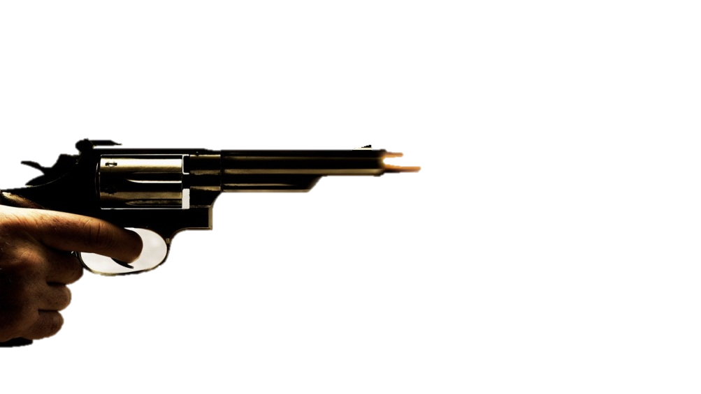

Shoot a bullet at the wall
Lets us consider this example where we will shoot the bullet at the wall.
Bullet will penetrate the wall
What do you think will happen????
Bullet will penetrate

Slide 9
Throw a bullet (of same mass) on the wall
What will happen??
Bullet will not penetrate!!!
Why??
The speed of the bullet is very less.
Let us understand what is momentum????
impact
MOMENTUM

Slide 10
MOMENTUM (p)
Momentum(p) of an object is defined as product of its
mass (m) and velocity (v)
Momentum
mass
=
×
velocity
p
=
m
×
v
p
=
mv
Needs both magnitude & direction
Momentum is a vector quantity
vector
UNIT
g
v
cm
ms⁻¹
s
m
×
⁻¹
p
kg
=
SI / MKS
p
=
CGS
p
=

Slide 11
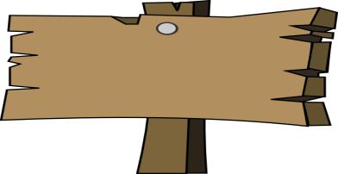
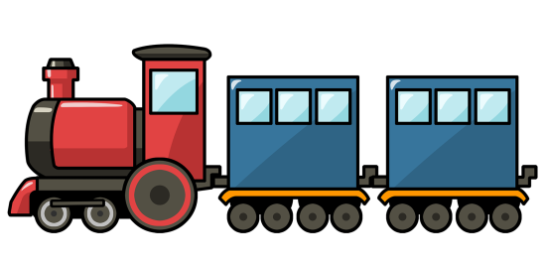
Hence, it can be concluded that the force necessary to change the momentum of an object depends on the time rate at which the momentum is changed.
Newton’s Second Law of Motion
As the train begins to move it will gain speed when Force is exerted.
This means there is a change in the momentum of the train.
The second law of motion states that the rate of change of
momentum of an object is proportional to the applied
unbalanced force in the direction of force.
The change in the momentum depends on not only the force applied but also the time during which the force is exerted.
Initially the train is at rest so initial velocity (u) is zero
Let us consider a train travelling from Mumbai to Pune
zero
Pune
Mumbai
If one quantity increases the other quantity also increases accordingly.

Slide 12
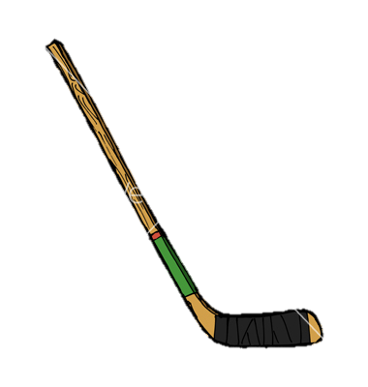

MATHEMATICAL FORMULATION OF SECOND LAW OF MOTION
With respect to time
p₁
=
mu
p₂
=
mv
Change in momentum
=
p₂
−
p₁
Applied force is directly proportional to the rate of change of momentum.
Let P₁ be the initial momentum
P₂ be the final momentum
−
mu
mass x final velocity
=
mv
mass x initial velocity
Let us consider an object of mass (m) moving with an initial velocity (u) along a straight line.
=
m
(v-u)
Consider the final velocity to be v.
A constant force F is applied for time t.
Final - initial
m
×
Rate of Change of momentum
(v-u)
=
‘k’ is the proportionality constant.
t
According to second law of motion
‘a’ is the acceleration i.e. rate of change of velocity.
m
v
×
(v-u)
u
F
∝
t
m(v-u)
F
=
k
m
t
v-u
F
=
kma
a
=
∴
t
If
k
=
Then
1,
F
=
ma

Slide 13
State the first law of motion mathematically from the mathematical expression for the second law of motion.
Mathematical expression for Newton’s second law of motion is :
This means that an object will continue to be at rest or uniform motion unless a force acts.
This is nothing but the first law of motion.
F
=
ma
Then the object will remain at rest.
m (v-u)
F
=
m (v-u)
t
∴
a
=
t
or
Ft
=
mv
−
mu
When no external force is acting.
when
F
=
0
Then
v
=
u
This means that object is moving with uniform velocity throughout time (t).
If
u
=
0
then
v
=
0
Thus the first law of motion is stated mathematically from second law of motion.

Slide 14
So let us define Force.
A force is that physical cause which changes (or tends to change) either the size or shape or the state of rest or motion of the body.
m is Mass
a is acceleration
Tries to change.
Force Equation
Force is a VECTOR quantity.
F
=
ma
kg
g
ms⁻²
cms⁻²
Needs both magnitude and direction.
units
SI/MKS
CGS
Newton (N)
dyne

Slide 15
Relation between SI unit & CGS unit of Force
SI unit of Force
1 kg = 1000 g.
F
=
ma
1 m = 100cm.
1 newton
=
1kg
×
1 ms⁻²
1 N
=
10³g
×
10² cms⁻²
1 g cms⁻² is nothing but 1 dyne.
∴
1 N
=
10⁵g cms⁻²
∴
1 N
=
10⁵ dyne
∴
1 N
=
10⁵ dyne

Slide 16
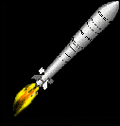
Newton’s third law of motion:
The third law of motion states that when one object exerts a force on another
object, the second object instantaneously exerts a force back on the first.
The rocket exerts a downward force on the gases. The gases in turn exerts an equal and opposite force which will propel the rocket in to the space.
These two forces are equal in magnitude but opposite in direction.

Slide 17
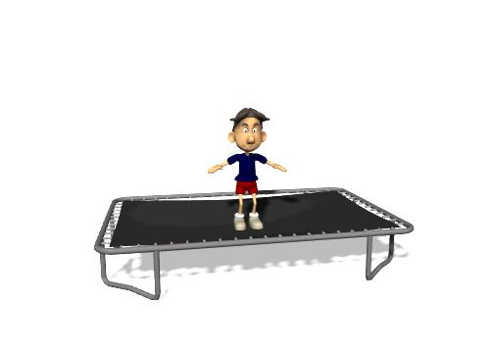
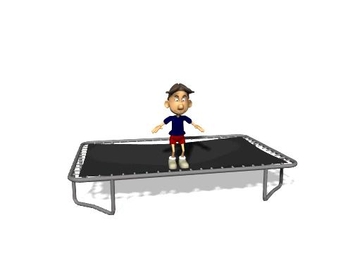
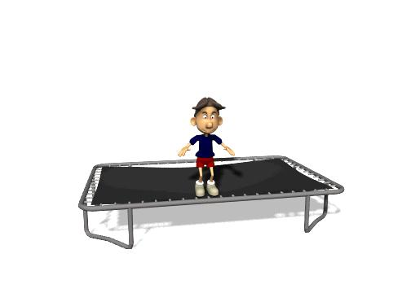
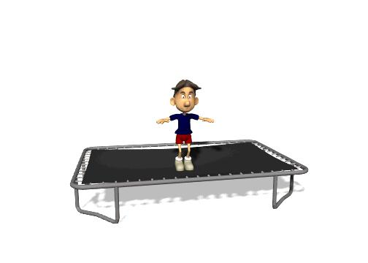
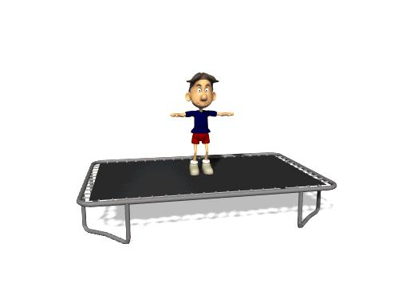
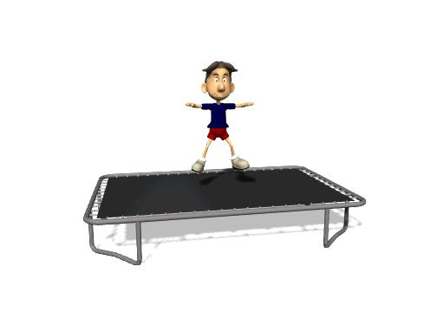
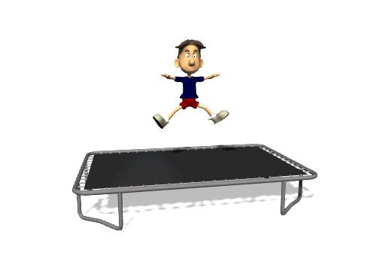
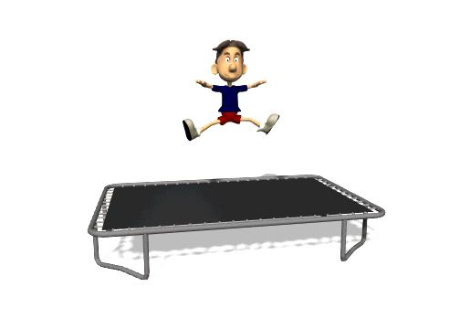
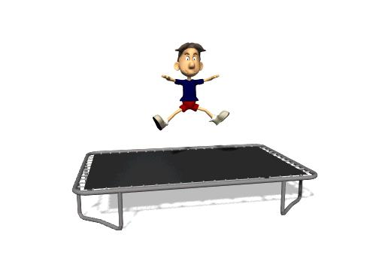
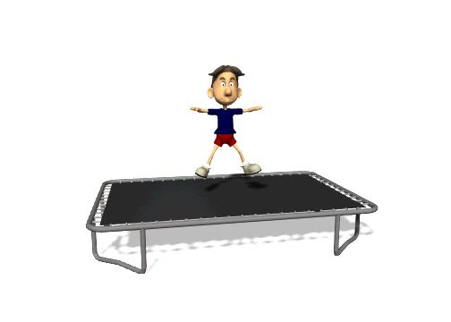
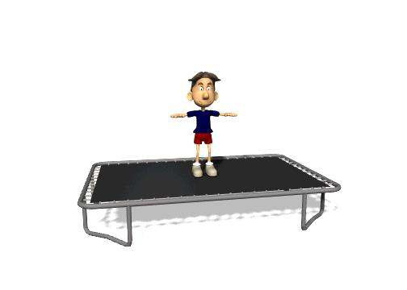
The Law speaks about :
What does Newton want to say in his Third Law????
Boy and trampoline.
If the forces are equal and opposite they should cancel each other.
Interaction between bodies
Lets us consider this example where the boy is on the trampoline.
When he is jumping he is applying a downward force on the trampoline.
Now the trampoline will exert an equal force
but in the opposite direction.
Force is never isolated but always exist in pairs.
single
Force, though they are equal and opposite, they never cancel each other.
For every action there is a reaction which are equal and opposite.
As the forces act on different bodies (boy and the trampoline) they do not cancel each other.

Slide 18


A and B collide. Object A exerts a Force F_{AB} on object B.
Object B exerts a force F_{BA} on object A.
Law of conservation of momentum:
Consider two object A and B a travelling in the same direction along a straight line.
The sum of momentum of the two objects before collision is equal to the sum of momentum after the collision provided there is no external unbalanced force acting on them.
A
B
F_{AB}
F_{BA}
object A
object B
_{mass}
m_{A}
m_{B}
_{Initial}
velocity
u_{A}
u_{B}
u_{A} > u_{B}
_{Final}
velocity
v_{A}
v_{B}

Slide 19
Law of conservation of momentum:
Momentum of object A
Momentum of object B
Before collision m_{A} u_{A}
Before collision m_{B} u_{B}
‘t’ is time of collision
For every action there is an equal and opposite reaction.
After collision m_{A} v_{A}
After collision m_{B} v_{B}
During collision :-
m_{A} (v_{A} – u_{A})
‘t’ is time of collision
Rate of change of momentum of object A
=
t
m_{B} (v_{B} – u_{B})
Rate of change of momentum of object B
=
t
According to third law of motion
F_{AB}
=
− F_{BA}
− ve sign indicates that direction is opposite
Sum of the final momentum of the two object A & B
Sum of the initial momentum of the two object A & B
m_{A} (v_{A} – u_{A})
m_{B} (v_{B} – u_{B})
=
t
t
This gives ,
m_{A} u_{A}
+
m_{B} u_{B}
=
m_{A} v_{A}
+
m_{B} v_{B}
Thus, The total momentum of the two objects remains unchanged or conserved provided no external force acts.

Slide 20

LAWS OF MOTION
Type A - Numerical

Slide 21
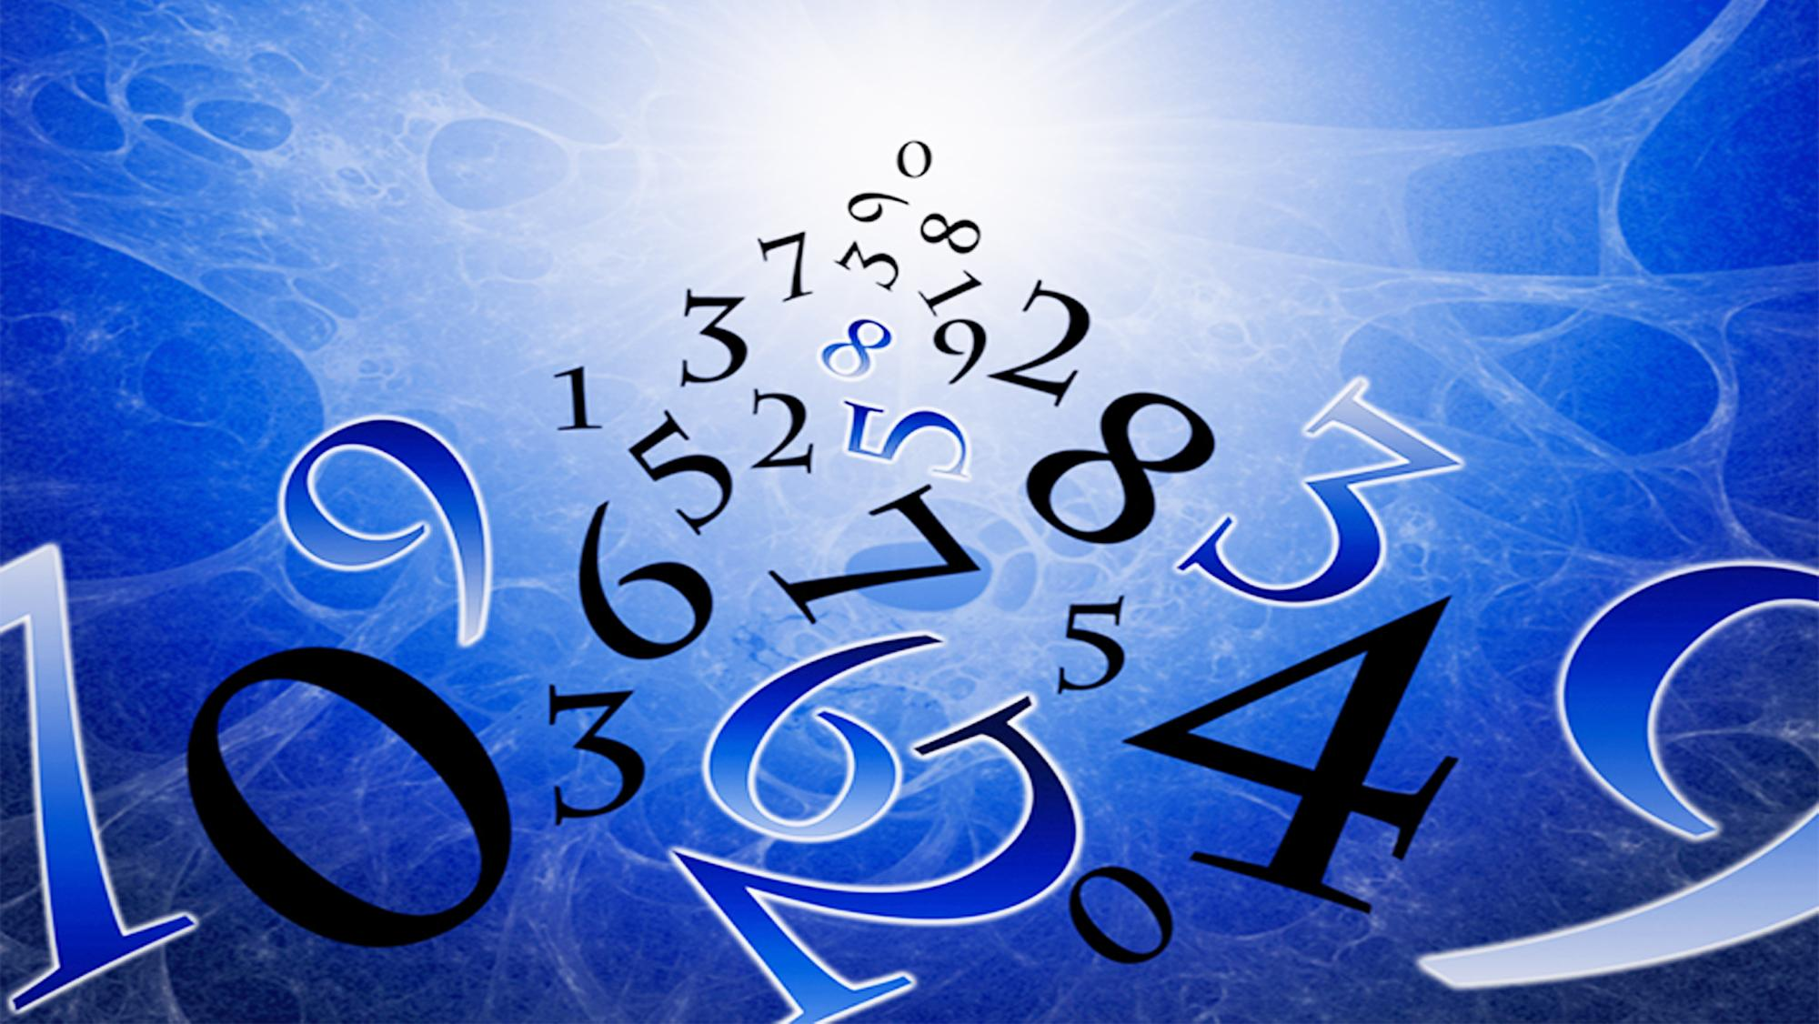

Type - A
F = ma
NUMERICAL
v-u
a
=
t

Slide 22

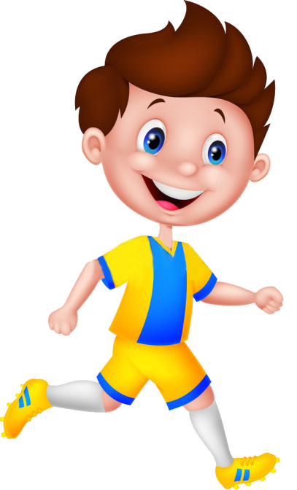

A constant force acts on an object of mass 5 kg for a duration of 2 s. It increases the object’s velocity from 3 m s⁻¹ to 7 m s⁻¹ . Find the magnitude of the applied force.
1
Force(F) = ?
Mass = 5 kg
Time(t) =2s
Final velocity(v) = 7 ms⁻¹
Initial velocity(u) = 3 ms⁻¹

Slide 23
A constant force acts on an object of mass 5 kg for a duration of 2 s. It increases the object’s velocity from 3 m s⁻¹ to 7 m s⁻¹ . Find the magnitude of the applied force.
1
Given :
Mass of the object (m)
=
5kg
Time (t)
=
2s
Initial velocity (u)
=
3 ms⁻¹
Final velocity (v)
=
7 ms⁻¹
To find :
Force (F)
=
?
(
-
u
v
)
Formulae :
F
=
ma
a
=
Ans :
t
Force acting on the object is 10 N.
(7 – 3)
Solution :
a
=
F
=
ma
2
4
=
5 × 2
∴
a
=
10N
2
=
∴
a
=
2ms⁻²

Slide 24
LAWS OF MOTION
Type A - Numerical

Slide 25

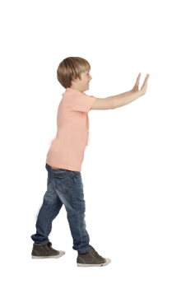
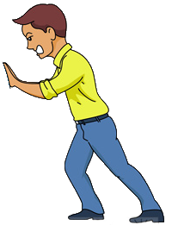

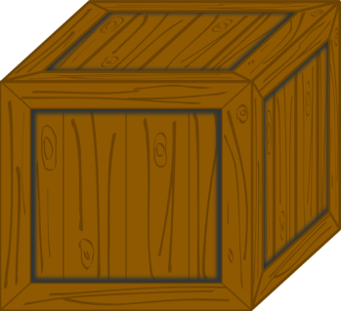
2
Which would require a greater force - accelerating a 2 kg mass at 5ms⁻² or a 4 kg mass at 2ms⁻² ?
Α
Β
Mass
m₁=2 kg
m₂=4 kg
Who has a greater force?
Acceleration
a₁=5 ms⁻²
a₂=2 ms⁻²
A
B
Acceleration (a) = 5ms⁻²
Acceleration (a) = 2ms⁻²
Mass(m) =2kg
Mass(m) =4kg

Slide 26
2
Which would require a greater force - accelerating a 2 kg mass at 5ms⁻² or a 4 kg mass at 2ms⁻² ?
Given :
Mass of 1st object (m₁)
=
2 kg
Mass of the 2nd object (m₂)
=
4 kg
Acceleration of the 1st object (a₁)
=
5ms⁻²
Acceleration of the 2nd object (a₂)
=
2ms⁻²
To find :
F₁
>
F₂
or
F₂
>
F₁
(ii)
F₂
=
m₂
a₂
Formula :
F
=
ma
∴
F₂
=
4
×
2
∴
F₂
=
8N
Solution :
(i)
F₁
=
m₁
a₁
F₁
>
F₂
F₁
=
2
∴
×
5
Ans :
∴
F₁
=
10N
Accelerating a 2 kg mass at
5ms⁻² requires a greater force.

Slide 27
Two persons manage to push a motorcar of mass 1200 kg at a uniform velocity along a level road. The same motorcar can be pushed by three persons to produce an acceleration of 0.2 ms⁻². With what force does each person push the motorcar?
(Assume that all persons push the motorcar with the same muscular effort.)
3
Given :
m
= 1200 kg
Ans :
Each person applies a force of magnitude 80 N
a
= 0.2 m s^{–2}
To find :
F
= ?
Formula :
F
= ma
Solution :
F
= ma
∴
F
= 1200
× 0.2
∴
F
= 240 N
Force Exerted by Each Person
240
= 80 N
=
3

Slide 28
LAWS OF MOTION
Type A - Numerical

Slide 29
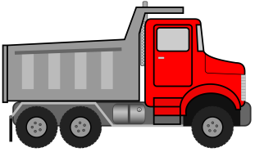
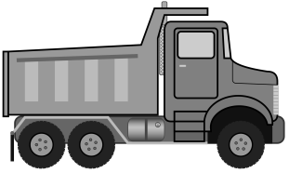
A truck starts from rest and rolls down a hill with a constant acceleration. It travels a distance of 400 m in 20s. Find its acceleration. Also find the force acting on it if its mass is 7 tonnes.
4
(Hint:1 tonne = 1000 kg.)
Initial velocity(u) = 0 ms⁻¹
a = ?
F = ?
time(t) =20s
Distance=400m
Mass(m) =7 tonnes

Slide 30
A truck starts from rest and rolls down a hill with a constant acceleration. It travels a distance of 400 m in 20s. Find its acceleration. Also find the force acting on it if its mass is 7 tonnes ( Hint:1 tonne = 1000 kg.)
4
Given :
Initial velocity (u)
=
0 ms⁻¹
Distance travelled (s)
=
400m
Time (t)
=
20s
Mass of truck (m)
=
7 tonnes
400
×
2
=
a
400
=
7000 kg
400
×
2
2ms⁻²
To find :
Acceleration (a)
=
?
∴
a
=
400
=
Force (F)
=
?
F
=
a
(ii)
m
Formulae :
1
m
∴
F
=
7000 × 2
(i)
s
u
t
+
t²
(ii)
=
a
=
2
a
F
∴
F
=
14000N
1
(i)
s
=
u
t
+
a
Solution :
2
t²
Ans :
1
a
The truck moves with an acceleration of 2ms⁻² and the force acting on it is 14000N .
400
=
0 × 20
+
×
20 × 20
2

Slide 31
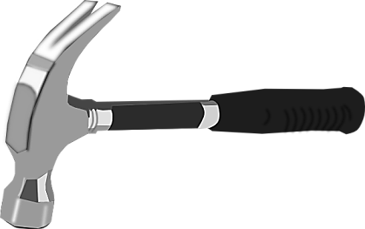

5
A hammer of mass 500 g, moving at 50 ms⁻¹, strikes a nail. The nail stops the hammer in a very short time of 0.01 s. What is the force of the nail on the hammer?
Mass (m) = 500 g
Initial Velocity (u) = 50 ms⁻¹
Final Velocity (v) = 0 ms⁻¹
Force (F) = ?
Time (t) = 0.01 s

Slide 32
5
A hammer of mass 500 g, moving at 50 ms⁻¹, strikes a nail. The nail stops the hammer in a very short time of 0.01 s. What is the force of the nail on the hammer?
500
– 50
Given :
m
= 500 g
=
∴
a
=
1000
0.01
= 0.5 kg
∴
a
=
- 5000 m s^{–2}
u
= 50 ms^{–1}
F
= ma
The –ve sign shows that the body is retarding
t
= 0.01 s
∴
F
= 0.5 × - 5000
v
= 0 ms^{–1}
∴
F
= - 2500N
To Find :
F
= ?
Ans:
v - u
Formulae :
(i)
a =
The force acting on the nail is -2500N. The negative sign shows that friction force being exerted.
t
(ii)
F
= ma
v - u
0 – 50
Solution :
a =
=
t
0.01

Slide 33
LAWS OF MOTION
Type A - Numerical

Slide 34
6
A stone of 1 kg is thrown with a velocity of 20ms⁻¹ across the frozen surface of a lake and comes to rest after travelling a distance of 50 m. What is the force of friction between the stone and the ice?

Slide 35



6
A stone of 1 kg is thrown with a velocity of 20ms⁻¹ across the frozen surface of a lake and comes to rest after travelling a distance of 50 m. What is the force of friction between the stone and the ice?
Mass(m) =1kg
Initial Velocity (u) = 20 ms⁻¹
Final Velocity (v) = 0 ms⁻¹
Distance (d) = 50m
Force (F) = ?

Slide 36
6
A stone of 1 kg is thrown with a velocity of 20m s⁻¹ across the frozen surface of a lake and comes to rest after travelling a distance of 50 m. What is the force of friction between the stone and the ice?
Given:
Mass of the stone (m)
=
1 kg
2as
=
0² - 20²
Initial velocity (u)
=
20 ms⁻¹
-8
-400
Final velocity (v)
=
0 ms⁻¹
a
=
2
×
50
Distance travelled (s)
=
50 m
∴
[-ve sign shows the retardation]
a
=
-4ms⁻²
To Find:
Force of friction (F)
=
?
=
m
(ii)
F
a
Formulae:
(i)
F
=
m
a
=
-4
∴
F
1
×
The –ve sign shows that the Force is acting in the opposite direction of the motion
(ii)
v²
=
u²
2
a
+
s
=
-4N
∴
F
Solution :
(i)
v²
=
u²
+
2as
Ans:
2as
=
v²
-
u²
Force of friction between ice and stone is -4N

Slide 37
LAWS OF MOTION
Type A - Numericals

Slide 38

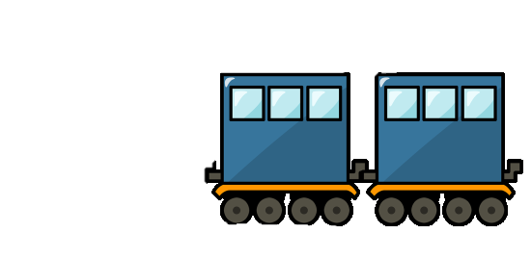

A 8000 kg engine pulls a train of 5 wagons, each of 2000 kg along a horizontal tracks. If the engine exerts a force of 40000 N and the track offers a friction force of 5000 N. Then calculate: (a)The net accelerating force (b)The acceleration of the train (c)The force of wagon 1 on wagon 2.
7
Mass of each wagon =2000kg
Mass(m) =8000kg
Force(F) =40000N
Force of Friction =5000N

Slide 39
A 8000 kg engine pulls a train of 5 wagons, each of 2000 kg along a horizontal tracks. If the engine exerts a force of 40000 N and the track offers a friction force of 5000 N. Then calculate: (a)The net accelerating force (b)The acceleration of the train (c)The force of wagon 1 on wagon 2.
7
Given :
Mass of engine
=
8000kg
Mass of each wagon
=
2000kg
Force Exerted By Engine
=
40000N
Friction force
=
5000N
To Find :
(a) Net accelerating force
(b)Acceleration of the train
(c) The force of wagon 1 on wagon 2
=
?
=
?
=
?
Formulae :
(a) Net accelerating force
=
Force exerted by engine
-
Force exerted by tracks
(b) F = ma
Acceleration of the train
F
(b)
Total Mass = Mass of Engine + Total mass of 5 Wagons
Total Mass = 8000 + 5(2000)
= 8000 + 10000
(a)
Solution :
=
m
(a) Net accelerating force
Force exerted by engine
Force exerted by tracks
∴
a
35000
=
-
=
=
1.94 ms⁻²
18000
=
40000
-
5000
Force of Wagon 1 on Wagon 2
Mass of 4 wagons behind wagon 1
(c)
=
×
a
=
35000N

Slide 40
A 8000 kg engine pulls a train of 5 wagons, each of 2000 kg along a horizontal tracks. If the engine exerts a force of 40000 N and the track offers a friction force of 5000 N. Then calculate: (a)The net accelerating force (b)The acceleration of the train (c)The force of wagon 1 on wagon 2.
7
Given :
Mass of engine
=
8000kg
Mass of each wagon
=
2000kg
Force Exerted By Engine
=
40000N
Friction force
=
5000N
To Find :
(a) Net accelerating force
(b)Acceleration of the train
(c) The force of wagon 1 on wagon 2
=
?
=
?
=
?
Formulae :
(a) Net accelerating force
=
Force exerted by engine
-
Force exerted by tracks
(b) F = ma
Acceleration of the train
F
(b)
(a)
Solution :
=
m
(a) Net accelerating force
Force exerted by engine
Force exerted by tracks
∴
a
35000
=
-
=
=
1.94 ms⁻²
18000
=
40000
-
5000
Force of Wagon 1 on Wagon 2
Mass of 4 wagons behind wagon 1
(c)
=
×
a
=
35000N
∴
F
=
=
8000 × 1.94
15520N

Slide 41
LAWS OF MOTION
Type A - Numerical

Slide 42

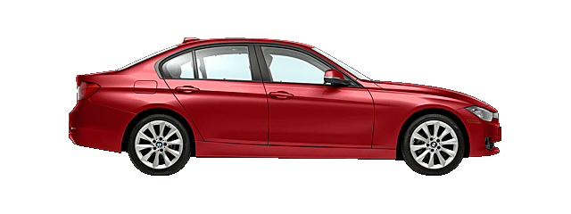
An Auto Mobile vehicle has mass of 1500kg. What must be the force between the vehicle and road if the vehicle is to be stopped with a negative acceleration of 1.7 ms⁻² ?
8
Mass(m) =1500kg
Final Velocity (v) =0ms⁻¹
Frictional Force (F) = ?
Negative Acceleration
(a) = 1.7 ms⁻²

Slide 43
An Auto Mobile vehicle has mass of 1500kg. What must be the force between the vehicle and road if the vehicle is to be stopped with a negative acceleration of 1.7 ms⁻² ?
8
Given :-
Mass of automobile (m)
=
1500 kg
acceleration (a)
=
-1.7ms⁻²
To Find:
Force of friction (F)
=
?
Formula:
F
=
ma
Solution :
F
=
ma
F
=
1500
×
-1.7
The –ve sign shows that the Force is acting in the opposite direction of the motion
F
=
- 2550 N
Answer:
The Force between the vehicle and the road is -2550 N.

Slide 44
A force of 5N gives a mass m₁, an acceleration of 10ms⁻² and a mass m₂, an acceleration of 20ms⁻². What acceleration would it give if both the masses were tied together?
9
F
m₂ × a₂
Given:
a₁
=
10 ms⁻²
a₂
=
20 ms⁻²
=
F
=
5 N
F
m₂
=
To Find:
Total acceleration (a)
?
a₂
=
5
1
m₂
=
=
=
0.25kg
Formula:
(i)
F
=
ma
20
4
Total Mass
=
0.5 + 0.25
=
0.75kg
Solution:
F
=
ma
F
=
m₁ × a₁
F
=
ma
F
F
5
m₁
=
a
=
=
=
6.67 ms⁻²
a₁
m
0.75
5
1
Ans:
The total acceleration produced is 6.67 ms⁻².
m₁
=
=
=
0.5kg
10
2

Slide 45
LAWS OF MOTION
Type A - Numericals

Slide 46
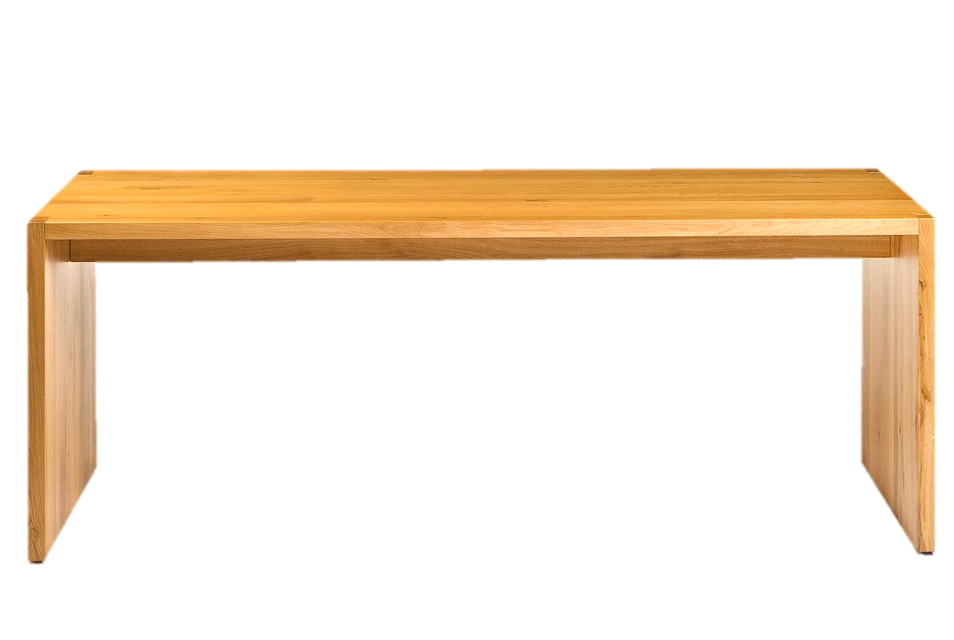
The velocity-time graph of a ball of mass 20g moving along a straight
line on a long table is given in the figure. How much force does the
table exert on the ball to bring it to rest?
10
25
20
Force of Friction (F) = ?
Velocity (cm/s) →
15
10
5
Initial Velocity (u) =20cms⁻¹
1
2
3
4
5
6
7
8
9
10
11
Mass(m) =20g
time (s) →
Final Velocity (v) =0ms⁻¹

Slide 47
10
The velocity-time graph of a ball of mass 20g moving along a straight
line on a long table is given in the figure. How much force does the
table exert on the ball to bring it to rest?
20
25
=
20 g
Given :
Mass of ball (m)
=
=
0.02 kg
1000
20
Initial velocity (u)
=
20 cms⁻¹
=
0.2 ms⁻¹
Velocity (cm/s) →
15
Final velocity (v)
=
0 cms⁻¹
=
0 ms⁻¹
10
Time taken (t)
=
10 s
5
1
2
3
4
5
6
7
8
9
10
11
To Find :
Force of friction on the ball (F)
=
?
F
=
m
a
time (s) →
-
u
v
(-0.02)
(a)
a
0.02
=
-0.0004 N
Formulae :
F
=
m
a
(b)
=
∴
F
=
×
t
0
-
0.2
Ans:
Solution :
a
=
10
Force exerted is -0.0004N. The negative sign shows that friction force is exerted by the table.
a
=
-0.02ms⁻²
Acceleration of the ball in – 0.02ms⁻²

Slide 48

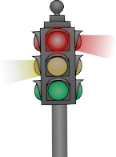
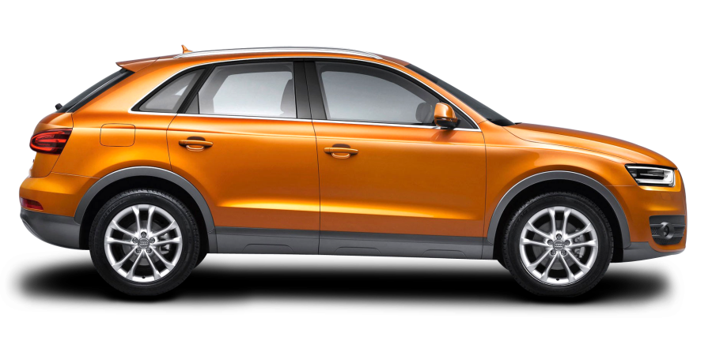


A motorcar is moving with a velocity of 108km/h and it takes 4s to stop after the brakes are applied. Calculate the force exerted by the brakes on the motorcar if its mass along with the passengers is 1000kg.
11
Force (F) = ?
Final Velocity(v) = 0 km/h
Initial Velocity(u) = 108 km/h
Mass(m) = 1000 kg
Time(t) = 4 s

Slide 49
A motorcar is moving with a velocity of 108km/h and it takes 4s to stop after the brakes are applied. Calculate the force exerted by the brakes on the motorcar if its mass along with the passengers is 1000kg.
11
u
1000
=
Given :
=
108km/h
=
×
30 ms⁻¹
F
108
=
ma
60 × 60
v
=
0 ms⁻¹
F
1000 × - 7.5
=
t
=
4s
F
=
-7500 N
m
=
1000kg
Ans:
To Find:
F
=
?
Force exerted by the brakes is 7500N. Negative sign indicates retarding force.
v - u
Formulae:
(i)
F
a
=
(ii)
=
ma
t
The –ve sign shows that the body is retarding
v - u
0 - 30
- 30
Solution:
a
=
=
=
t
4
4
∴
a
=
- 7.5 ms⁻²

Slide 50
LAWS OF MOTION
Type A - Numericals

Slide 51




A bullet of mass 10 g travelling horizontally with a velocity of 150 ms⁻¹ strikes a stationary wooden block and comes to rest in 0.03 s. Calculate the distance of penetration of the bullet into the block. Also calculate the magnitude of the force exerted by the wooden block on the bullet.
12
Velocity(u) =150ms⁻¹
Force (F) = ?
Time(t) =0.03 s
Mass(m) =10g
Distance of penetration

Slide 52
A bullet of mass 10 g travelling horizontally with a velocity of 150 ms⁻¹ strikes a stationary wooden block and comes to rest in 0.03 s. Calculate the distance of penetration of the bullet into the block. Also calculate the magnitude of the force exerted by the wooden block on the bullet.
12
Solution:
v
u
=
+
a
t, 0
=
150
+
a
×
0.03
Given :
mass
(m)
=
10
g
=
0.010
kg
0.03
a
=
-
150
- 5000
Initial velocity
(u)
=
150
ms⁻¹
-
150
-
a
=
=
15000
=
-
5000
ms⁻²
Final velocity
(v)
=
0
ms⁻¹
0.03
3
time taken
(t)
=
0.03
v²
=
u²
+
2as
s
2as
=
v²
-
u²
-ve Sign shows that it is retardation
To Find :
(a)
distance travelled
(s)
=
?
2as
=
0
-
u²
(
×
)
9
(b)
force exerted
=
?
-
150
150
=
=
(F)
s
=
2.25
×
(
)
4
-
2
5000
-ve Sign shows that it is Force of Friction
v
=
u
+
a
Formulae:
t
penetration
=
m
Distance
of
2.25
=
a
F
m
v²
=
u²
+
2as
=
×
-
F
0.01
5000
=
-
50 N
=
a
F
m

Slide 53
LAWS OF MOTION
Type B - Numerical

Slide 54
Type - B
p = mv
NUMERICAL
Δp = mv - mu

Slide 55
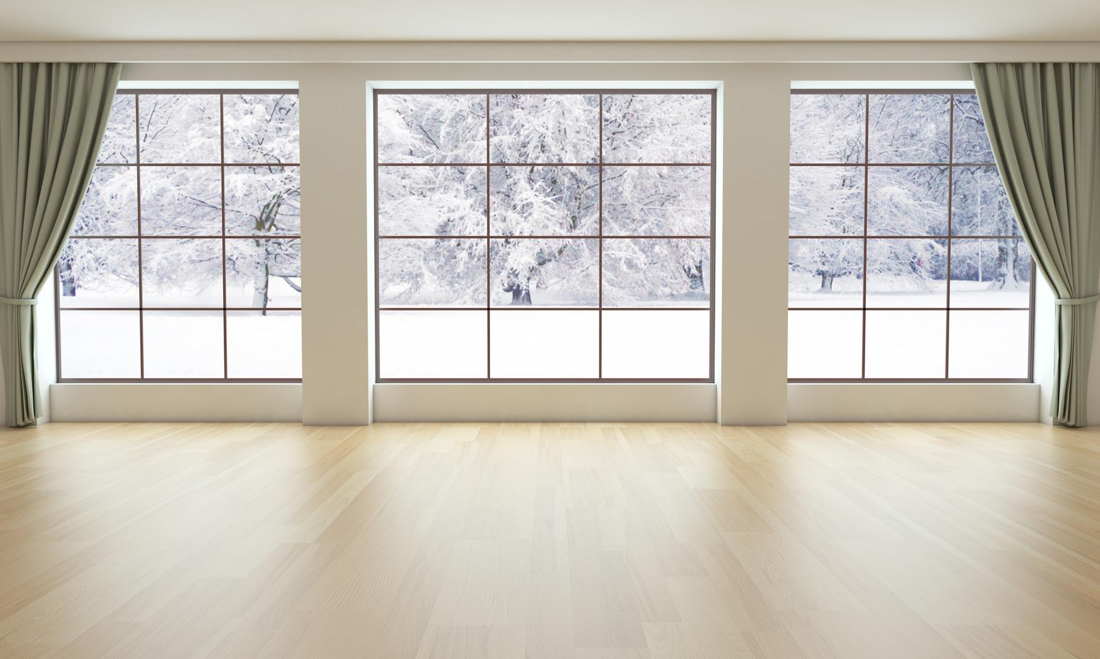
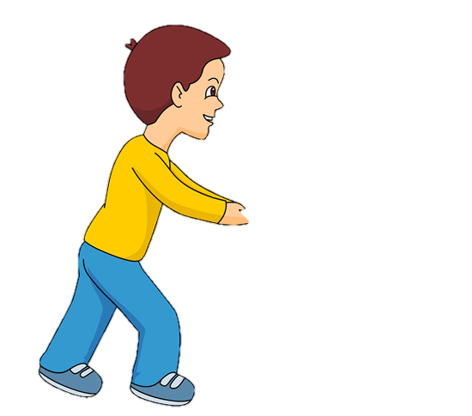

An object of mass 100 kg is accelerated uniformly from a velocity of 5 ms⁻¹ to 8 ms⁻¹ in 6s. Calculate the initial and final momentum of the object. Also find the magnitude of the force exerted on the object.
1
Velocity(v) = 8 ms⁻¹
Initial Velocity(u) = 5 ms⁻¹
Time(t) = 6s
Mass(m) =100kg

Slide 56
An object of mass 100 kg is accelerated uniformly from a velocity of 5 ms⁻¹ to 8 ms⁻¹ in 6s. Calculate the initial and final momentum of the object.
Also find the magnitude of the force exerted on the object.
1
Solution:
Given:
Mass (m)
=
100 kg
(a) Initial momentum (p₁)
=
mu
Initial velocity (u)
=
5 ms⁻¹
=
100
×
5
=
500
kg ms⁻¹
Final velocity (v)
=
8 ms⁻¹
(b) Final momentum (p₂)
=
mv
Time taken (t)
=
6 s
=
100
To Find:
(a) Initial momentum (p₁)
×
8
=
800
kg ms⁻¹
=
?
(b) Final momentum (p₂)
v-u
=
?
(c) a
=
t
F
(c) Force exerted (F)
=
?
=
ma
-
8
5
∴
F
=
100
×
∴
a
=
0.5
Formulae:
(a) p
ma
=
mv
(b) F
=
6
₁
∴
F
=
50
v-u
3
N
(c) a
=
∴
a
=
t
6
₂
Force exerted is 50 N
∴
a
=
0.5
ms⁻²

Slide 57
A hockey ball of mass 200 g travelling at 10 ms^{–1} is struck by a hockey stick so as to return it along its original path with a velocity at 5 ms^{–1}. Calculate the change of momentum occurred in the motion of the hockey ball by the force applied by the hockey stick.
2
200
Given:
m
= 200g
=
= 0.2 kg
1000
The negative sign indicates that the object is moving in opposite direction
u = 10 m/s
v = - 5 m/s
To Find:
Change of momentum (Δp) = ?
Formulae:
Δp = mv - mu
Solution:
Δp = mv - mu
Δp = (0.2 × -5) – (0.2 × 10)
Δp = -1 - 2
The negative sign indicates that the object is moving in opposite direction
Δp = - 3 kgms⁻¹
Ans:
Change of momentum is 3kgms⁻¹.

Slide 58
LAWS OF MOTION
Type B - Numerical

Slide 59

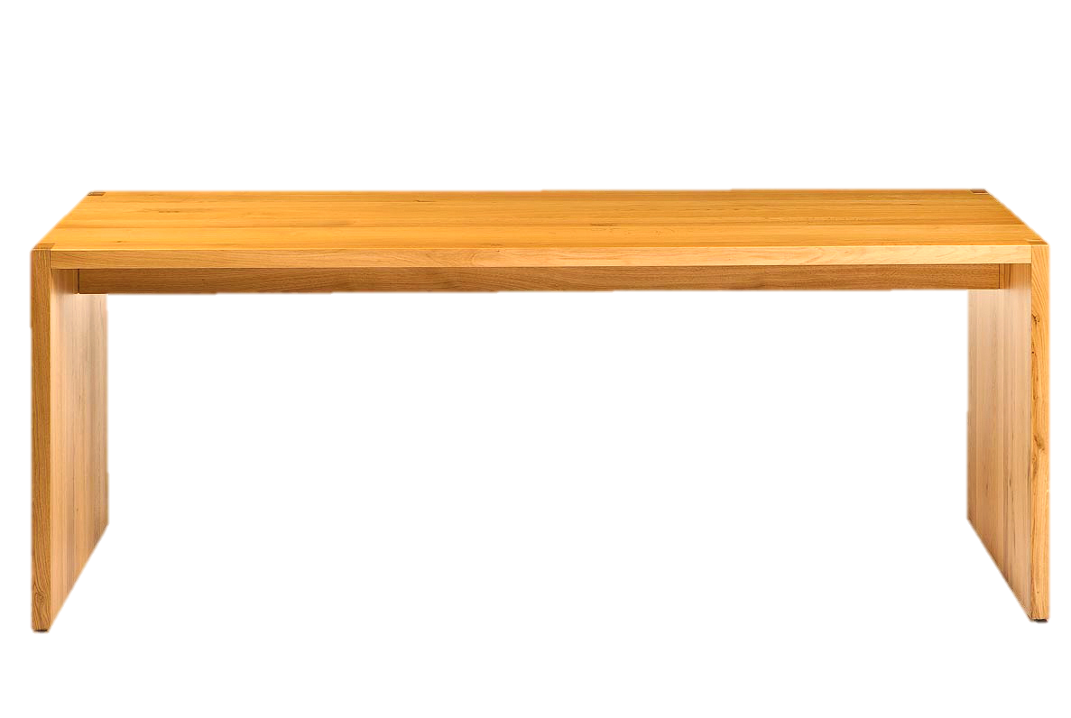
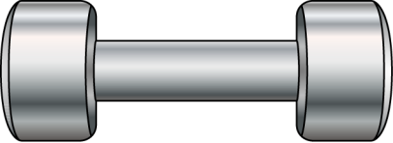
How much momentum will a dumb-bell of mass 10 kg transfer to the floor if it falls from a height of 80 cm ? Take its downward acceleration to be 10 ms⁻².
3
Acceleration (a) = 10 ms⁻².
Mass(m) =10kg
Height(h) = 80 cm

Slide 60
How much momentum will a dumb-bell of mass 10 kg transfer to the floor if it falls from a height of 80 cm ? Take its downward acceleration to be 10 ms⁻².
3
Given :
mass (m)
=
10 kg
Solution :
v²
=
u²
+
2as
height (s)
=
80 cm
∴
v²
=
0²
+
2
×
10
×
0.8
80
v²
=
16
=
=
0.8 m
0.8
100
∴
v
=
√16
Acceleration (a)
=
10 ms⁻²
v
=
4
4 ms⁻¹
Initial velocity (u)
=
0 ms⁻¹
p
=
mv
To Find :
Momentum (p)
=
?
∴
p
=
10
×
4
∴
p
=
40 kg ms⁻¹
Formulae :
a)
p
=
mv
Ans:
The momentum transferred to the floor is 40 kgms⁻¹.
b)
v²
=
u²
+
2as

Slide 61
A motorcar of mass 1200 kg is moving along a straight line with a uniform velocity of 90 km/h. Its velocity is slowed down to 18 km/h in 4 s by an unbalanced external force. Calculate the acceleration and change in momentum. Also calculate the magnitude of the force required.
4
Mass(m) = 1200 Kg
Initial Velocity(u) = 90 km/h
Final Velocity(v) = 18 km/h
Time(t) = 4 s

Slide 62
A motorcar of mass 1200 kg is moving along a straight line with a uniform velocity of 90 km/h. Its velocity is slowed down to 18 km/h in 4 s by an unbalanced external force. Calculate the acceleration and change in momentum. Also calculate the magnitude of the force required.
4
Formulae :
v
-
u
Given :
Mass (m)
=
1200 kg
a
=
t
Initial velocity (u)
=
90 km/h
Change in momentum
mv
-
mu
F
ma
5
=
=
5
=
90
×
m/s
Solution :
18
1
=
25 ms⁻¹
v
-
u
5
-
25
-20
a
(i)
=
=
=
=
-5 ms⁻²
Final velocity (v)
=
18 km/h
t
4
4
1
5
=
18
×
m/s
Change in momentum
m
( v
-
=
mv
u )
-
(ii)
mu
=
1200
(
-
)
18
=
5
25
=
5 ms⁻¹
1
-20
-24000 kg ms⁻¹
=
1200
=
Time taken (t)
=
4 s
×
(iii)
Force exerted (F)
ma
-5
=
=
-6000 N
1200
To Find :
(i)
Acceleration (a)
=
?
=
×
(ii)
Change in momentum
=
?
Acceleration is 5ms⁻² and the change in momentum is 24000kgms⁻¹. The magnitude of force is 6000N
Ans:
(iii)
Force exerted (F)
=
?

Slide 63
LAWS OF MOTION
Type C - Numerical

Slide 64
Type - C
m₁u₁ + m₂ u₂ = m₁v₁ + m₂ v₂
Where,
NUMERICAL
u
=
Initial velocity
m
=
Mass of the body
v
=
Final velocity
Note:
Total Momentum before collision = Total Momentum after collision

Slide 65

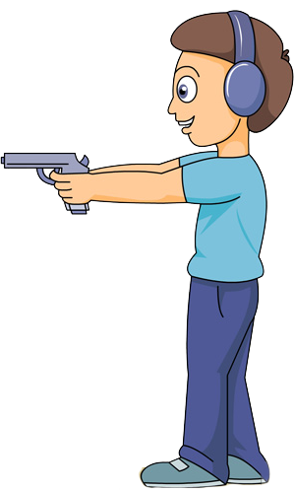


A bullet of mass 20 g is horizontally fired with a velocity 150 ms⁻¹ from a pistol of mass 2 kg. What is the recoil velocity of the pistol?
1
Mass (m₁) = 20 g
Mass (m₂) = 2 kg
Final Velocity (v₂) = ?
Initial Velocity (u₂) = 0 ms⁻¹
Final Velocity (v₁) = 150 ms⁻¹
Initial Velocity (u₁) = 0 ms⁻¹

Slide 66
A bullet of mass 20 g is horizontally fired with a velocity 150 ms⁻¹ from a pistol of mass 2 kg. What is the recoil velocity of the pistol?
1
Mass of the bullet (m₁)
=
20 g
Given:
Solution:
m₁
u₁
+
m₂
u₂
=
m₁
v₁
=
0.02 kg
+
m₂
v₂
0.02
v₂
(
×
0
)
+
2
(
×
0
)
=
0.02
(
×
150
)
+
(
2
Mass of the pistol (m₂)
=
2 kg
×
)
Initial velocity of bullet (u₁)
=
0 ms⁻¹
0
=
(
+
2
3
)
v₂
Initial velocity of pistol (u₂)
=
0 ms⁻¹
2
-
v₂
=
3
Final velocity of bullet (v₁)
=
150 ms⁻¹
-
3
∴
v₂
=
2
∴
v₂
=
-
1.5
To Find:
Recoil velocity of pistol (v₂)
ms⁻¹
=
?
Ans:
Recoil velocity of the pistol is -1.5ms⁻¹. Negative sign shows that the pistol moves in the opposite direction of bullet.
Formula:
m₁
u₁
+
m₂
u₂
=
m₁
v₁
+
m₂
v₂

Slide 67
From a rifle of mass 4 kg, a bullet of mass 50 g is fired with an initial velocity of 35 ms⁻¹. Calculate the recoil velocity of the rifle.
2
Mass (m₁) = 50 g
Mass (m₂) = 4 kg
Final Velocity (v₂) = ?
Initial Velocity (u₂) = 0 ms⁻¹
Final Velocity (v₁) = 35 ms⁻¹
Initial Velocity (u₁) = 0 ms⁻¹

Slide 68
From a rifle of mass 4 kg, a bullet of mass 50 g is fired with an initial velocity of 35 ms⁻¹. Calculate the recoil velocity of the rifle.
2
m₂
50
∴
v₂
=
-0. 4375 ms⁻¹
Given :
=
4 kg
m₁
=
50 g
=
= 0.05 kg
u₂
1000
u₁
=
0ms⁻¹
=
0ms⁻¹
Ans:
v₁
=
35ms⁻¹
The rifle recoils with a velocity of 0.4375 ms⁻¹. The negative sign indicates that the rifle recoils backwards.
To Find:
v₂
=
?
Formula:
m₁u₁ + m₂u₂ = m₁v₁ + m₂v₂
Solution:
m₁u₁
+ m₂u₂
=
m₁v₁
+ m₂v₂
∴
(0.05 × 0) + (4 × 0)
=
(0.05 × 35) + (4 × v₂)
∴
0
=
1.75 + 4v₂
∴
-4v₂
=
1.75
-1.75
∴
v₂
=
4

Slide 69
LAWS OF MOTION
Type C - Numericals

Slide 70


A girl of mass 40 kg jumps with a horizontal velocity of 5 ms⁻¹ onto a stationary cart with frictionless wheels. The mass of the cart is 3 kg. What is her velocity as the cart starts moving ? Assume that there is no external unbalanced force working in the horizontal direction.
3
Initial Velocity(u₁) = 5ms⁻¹
Mass (m₁) = 40kg
Final Velocity (v) = ?
Mass (m₂) = 3kg
Initial Velocity(u₂) = 0ms⁻¹

Slide 71
A girl of mass 40 kg jumps with a horizontal velocity of 5 ms⁻¹ onto a stationary cart with frictionless wheels. The mass of the cart is 3 kg. What is her velocity as the cart starts moving ? Assume that there is no external unbalanced force working in the horizontal direction.
3
Given :
Mass of the girl (m₁)
=
40 kg
Mass of the cart (m₂)
=
3 kg
200
v =
= 4.65 ms⁻¹
Initial velocity of girl (u₁)
=
5 ms⁻¹
43
Initial velocity of cart (u₂)
=
0 ms⁻¹
Ans:
Her velocity as the cart starts moving is 4.65 ms⁻¹.
To find :
Final velocity of girl (v)
=
?
Formula :
m₁
u₁
+
m₂
u₂
=
m₁
v₁
+
m₂
v₂
Solution :
m₁
u₁
+
m₂
u₂
=
m₁
v₁
+
m₂
v₂
40×5
+
3×0
=
40v + 3v
200
=
43v

Slide 72
Mass(m) = 1 Kg
Velocity(v) = 10 m s⁻¹
An object of mass 1 kg travelling in a straight line with a velocity of 10 m s⁻¹ collides with, and sticks to, a stationary wooden block of mass 5 kg. Then they both move off together in the same straight line. Calculate the total momentum just before the impact and just after the impact. Also, calculate the velocity of the combined object.
4
Given :
Mass of Object m₁
= 1 kg
Total momentum after impact
Mass of Wooden Block m₂
= 5 kg
∴
=
10 kg ms^{–1}.
Initial Velocity of the object u₁
= 10 ms^{–1}
Velocity of the combined object:
Initial Velocity of the wooden Block u₂
= 0 ms^{–1}
Ans :
Total momentum just after collision is 10 kg ms^{–1}. Total momentum just before impact is 10 kg ms^{–1}. Velocity of the combined object is 1.67 ms^{–1}.
To find :
v₁
= v₂
= v
= ?
m₁u₁ + m₂u₂
= m₁v₁ + m₂v₂
Formula :
m₁u₁ + m₂u₂
= m₁v₁ + m₂v₂
1
× 10
+ 5
× 0
= 1
× v
+ 5
× v
Solution :
10
= 6 v
Total momentum before impact
=
m₁u₁ + m₂u₂
10
5
=
1
× 10
+ 5
× 0
v
=
=
6
3
=
10 kg ms^{–1}
v
= 1.617 ms^{–1}
Total momentum after impact
Total momentum before impact
=

Slide 73
5
Two objects of masses 100g and 200g are moving along the same line and direction with velocities of 2 ms⁻¹ and 1 ms⁻¹, respectively. They collide and after the collision, the first object moves at a velocity of 1.67 ms⁻¹. Determine the velocity of the second object.
Given:
Mass of First Object (m₁)
= 100 g
= 0.1 kg
∴
0.2v₂
=
0.233
Mass of Second Object (m₂)
= 200 g
= 0.2 kg
0.233
Initial Velocity of First Object(u₁) = 2 ms⁻¹
v₂
=
=
1.165ms⁻¹
∴
Initial Velocity of Second Object(u₂) = 1 ms⁻¹
0.2
Final Velocity of First Object(v₁) = 1.67 ms⁻¹
To Find:
Velocity of Second Object (v₂) = ?
Velocity of the second object is 1.165ms⁻¹
Ans:
Formula:
m₁u₁ + m₂u₂ = m₁v₁ + m₂v₂
Solution:
m₁u₁
+ m₂u₂
=
m₁v₁
+ m₂v₂
∴
(0.1 × 2) + (0.2 × 1)
=
(0.1 × 1.67) + (0.2 × v₂)
∴
0.4
=
0.167 + 0.2v₂

Slide 74
LAWS OF MOTION
Type C - Numerical

Slide 75
6
Two objects, each of mass 1.5kg, are moving in the same straight line but in opposite directions. The velocity of each object is 2.5ms⁻¹ before the collision during which they stick together. What will be the velocity of the combined object after collision?
Initial Velocity = u₁ = u₂ = 2.5ms⁻¹
Mass (m₁) = 1.5kg
Mass (m₂) = 1.5kg

Slide 76
6
Two objects, each of mass 1.5kg, are moving in the same straight line but in opposite directions. The velocity of each object is 2.5ms⁻¹ before the collision during which they stick together. What will be the velocity of the combined object after collision?
Given:
m₁
= 1.5kg
m₂
= 1.5kg
(-) sign indicates that the object is moving in opposite direction
u₁ = 2.5 m/s
u₂ = -2.5 m/s
m₁
m₂
To Find:
v₁= v₂ = v ?
Formulae:
m₁u₁ + m₂u₂ = m₁v₁ + m₂v₂
Solution:
m₁u₁
+ m₂u₂
=
m₁v₁
+ m₂v₂
∴
(1.5 × 2.5) + (1.5 × -2.5)
=
(1.5 × v) + (1.5 × v)
∴
0
=
3v
∴
v
=
0ms⁻¹
Ans:
The velocity of the combined object after collision will be 0ms⁻¹.

Slide 77
Two hockey players of opposite teams, while trying to hit a hockey ball on the ground collide and immediately become entangled. One has a mass of 60kg and was moving faster with a velocity of 5ms⁻¹ while the other has a mass of 55kg was moving faster with a velocity 6ms⁻¹ towards the first player. In which direction and with what velocity will they move after they become entangled? Assume that the frictional force acting between the feet of the two players and the ground is negligible.
7
(+) towards right
(-) towards left
Given:
m₁
=
60kg
m₂
=
55kg
∴
-30
=
115v
u₁
=
+5ms⁻¹
u₂
=
-6ms⁻¹
v
=
-30
115
To Find:
Direction and Velocity after entangling
v
=
- 0.26 ms⁻¹
Formula:
m₁u₁ + m₂u₂ = m₁v₁ + m₂v₂
Ans:
Solution:
m₁u₁
+ m₂u₂
=
m₁v₁
+ m₂v₂
The two entangled players will move towards the left i.e. in the direction of 2nd Player with a velocity of 0.26ms⁻¹
∴
(60 × 5) + (55 × 6)
=
(60 × v) + (55 × v)
∴
300 + (-330)
=
v (60 + 55)

